Slide 1




Geostatistical data analysis II
(Spatial and spatiotemporal analysis using the INLA-SPDE approach)
C. Edson Utazi
October 2026

Slide 2
Learning objectives
At the end of this session, you will be able to:
Describe the structure of geostatistical models, including the observation model, linear predictor and latent spatial or spatiotemporal random effects.
Explain how spatial and spatiotemporal dependence is characterised in geostatistical models.
Explain the INLA-SPDE approach for approximating continuous spatial random fields and fitting Bayesian geostatistical models.
Evaluate geostatistical model performance using appropriate diagnostic tools, model comparison criteria and validation techniques.
Apply Bayesian spatial and spatiotemporal geostatistical models to real-world data using the inlabru R package, including spatial prediction and uncertainty quantification.

Slide 3
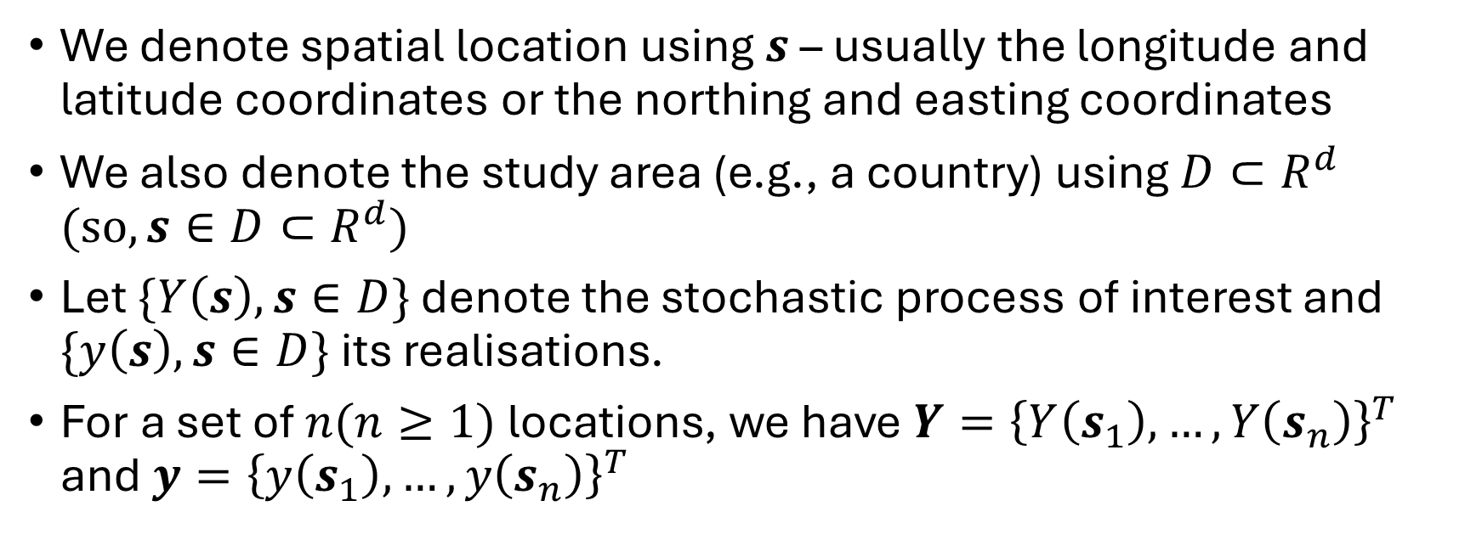
Model specification
We denote spatial location using $s$ – usually the longitude and latitude coordinates or the northing and easting coordinates
We also denote the study area (e.g., a country) using $D⊂R^{d}$ $(so, s∈D⊂R^{d})$
Let $\{Y\left(s\right), s∈D\}$ denote the stochastic process of interest and $\{y\left(s\right), s∈D\}$ its realisations.
For a set of $n(n≥1)$ locations, we have $Y={\left\{Y\left(s_{1}\right),…,Y\left(s_{n}\right)\right\}}^{T}$ and ${y=\left\{y\left(s_{1}\right),…,y\left(s_{n}\right)\right\}}^{T}$

Slide 4
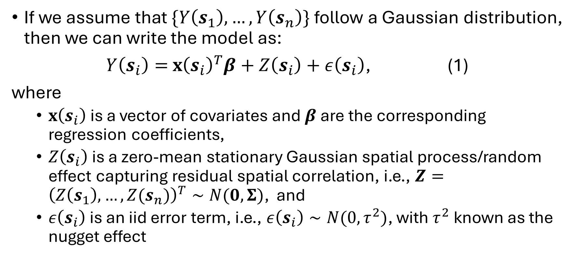
Model specification
If we assume that $\{Y\left(s_{1}\right),…,Y\left(s_{n}\right)\}$ follow a Gaussian distribution, then we can write the model as:
$Y\left(s_{i}\right)=$ $x{\left(s_{i}\right)}^{T}β+Z\left(s_{i}\right)+ε\left(s_{i}\right)$, (1)
where
  $x\left(s_{i}\right)$ is a vector of covariates and $β$ are the corresponding regression coefficients,
  $Z\left(s_{i}\right)$ is a zero-mean stationary Gaussian spatial process/random effect capturing residual spatial correlation, i.e., $Z={\left(Z\left(s_{1}\right),…,Z(s_{n})\right)}^{T}∼N(0, Σ)$, and
  $ε\left(s_{i}\right)$ is an iid error term, i.e., $ε\left(s_{i}\right)∼N(0,τ^{2})$, with $τ^{2}$known as the nugget effect

Slide 5
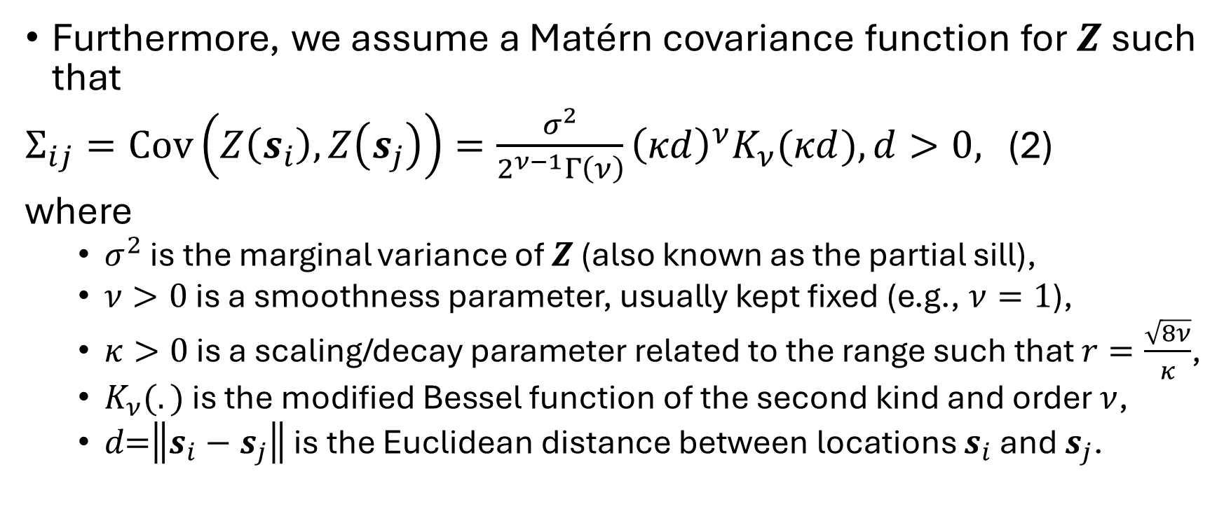
Model specification
Furthermore, we assume a Matérn covariance function for $Z$ such that
$Σ_{ij}=Cov\left(Z\left(s_{i}\right),Z\left(s_{j}\right)\right)=\frac{σ^{2}}{2^{ν−1}Γ\left(ν\right)}{\left(κd\right)}^{ν}K_{ν}(κd), d>0,$ (2)
where
  $σ^{2}$ is the marginal variance of $Z$ (also known as the partial sill),
  $ν>0\text{ is a smoothness parameter, usually kept fixed}$ (e.g., $ν=1$),
  $κ>0\text{ is a scaling/decay parameter related to the range such that }r=\frac{\sqrt{8ν}}{κ}$,
  $K_{ν}(.)\text{ is the modified Bessel function of the second kind and order }ν$,
  $d\text{=}\left\|s_{i}−s_{j}\right\|\text{ is the Euclidean distance between locations}$ $s_{i}$ and $s_{j}$.
Note that by construction, the Matérn covariance function for $Z$ satisfies the stationarity and isotropic assumptions discussed earlier.

Slide 6
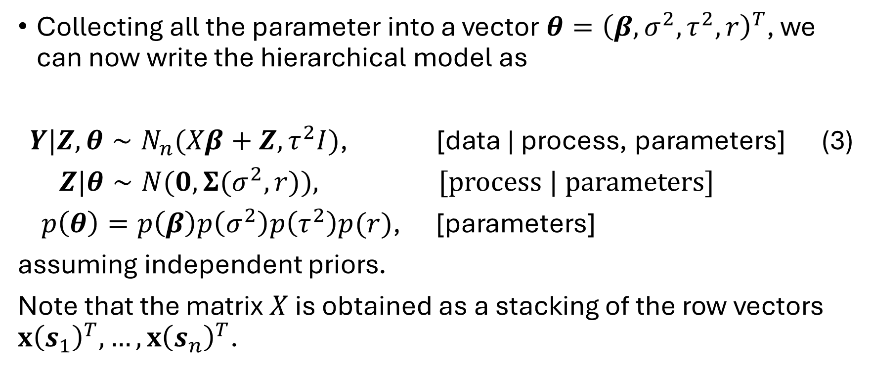
Model specification
Collecting all the parameter into a vector $θ={\left(β, σ^{2},τ^{2},r\right)}^{T}$, we can now write the hierarchical model as
$Y|Z,θ∼N_{n}(Xβ+Z, τ^{2}I)$, [data | process, parameters] (3)
$Z|θ∼N(0, Σ(σ^{2},r))$, [process | parameters]
$p\left(θ\right)=p\left(β\right)p\left(σ^{2}\right)p\left(τ^{2}\right)p(r)$, [parameters]
assuming independent priors.
Note that the matrix $X$ is obtained as a stacking of the row vectors $x{\left(s_{1}\right)}^{T},…,x{\left(s_{n}\right)}^{T}$.

Slide 7
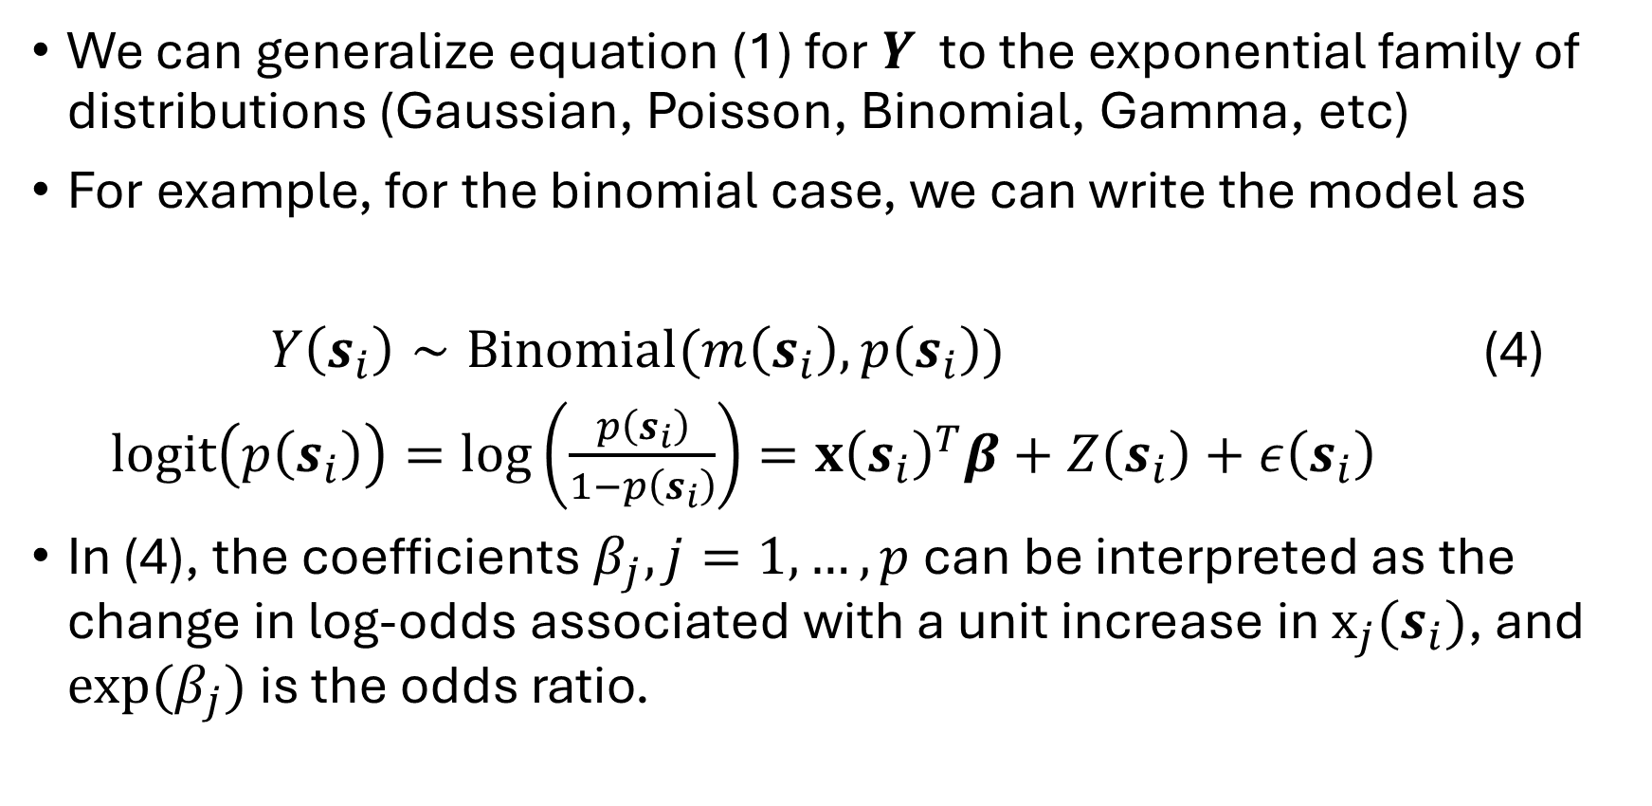
Model specification
We can generalize equation (1) for $Y$ $\text{to the exponential family of distributions (Gaussian, Poisson, Binomial, Gamma, etc)}$
For example, for the binomial case, we can write the model as
$Y\left(s_{i}\right)∼Binomial(m\left(s_{i}\right),p\left(s_{i}\right))$ (4)
$logit\left(p\left(s_{i}\right)\right)=\log\left(\frac{p\left(s_{i}\right)}{1−p\left(s_{i}\right)}\right)=x{\left(s_{i}\right)}^{T}β+Z\left(s_{i}\right)+ε\left(s_{i}\right)$
In (4), the coefficients $β_{j}, j=1,…,p$ can be interpreted as the change in log-odds associated with a unit increase in $x_{j}(s_{i})$, and $exp⁡(β_{j})$ is the odds ratio.

Slide 8
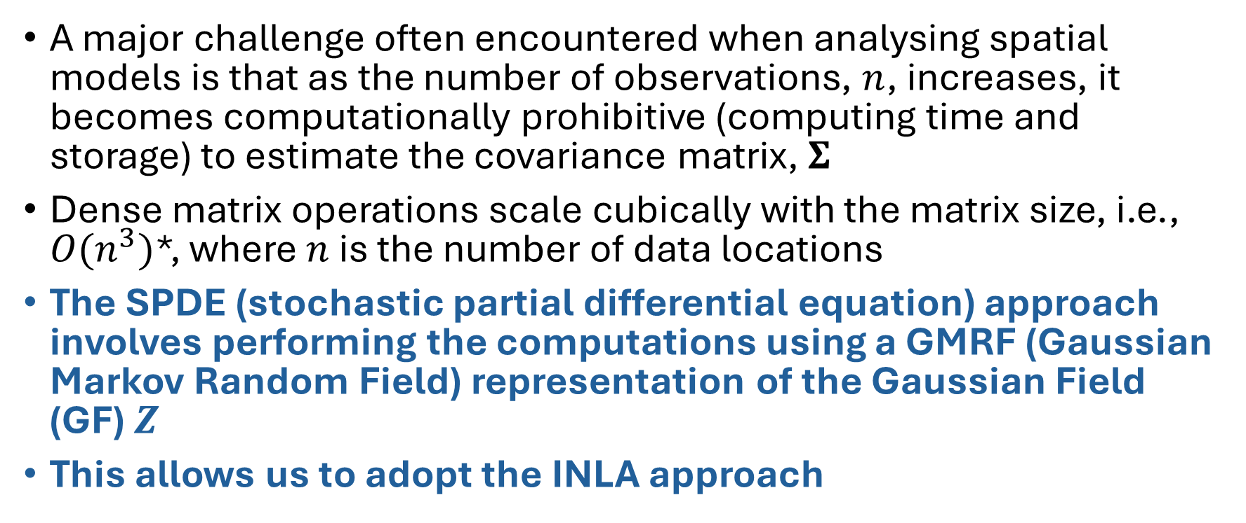
The INLA-SPDE approach
A major challenge often encountered when analysing spatial models is that as the number of observations, $n$, increases, it becomes computationally prohibitive (computing time and storage) to estimate the covariance matrix, $Σ$
Dense matrix operations scale cubically with the matrix size, i.e., $O(n^{3})$*, where $n$ is the number of data locations
The SPDE (stochastic partial differential equation) approach involves performing the computations using a GMRF (Gaussian Markov Random Field) representation of the Gaussian Field (GF) $Z$
This allows us to adopt the INLA approach
*approximately $n^{3}$ units of computational work

Slide 9
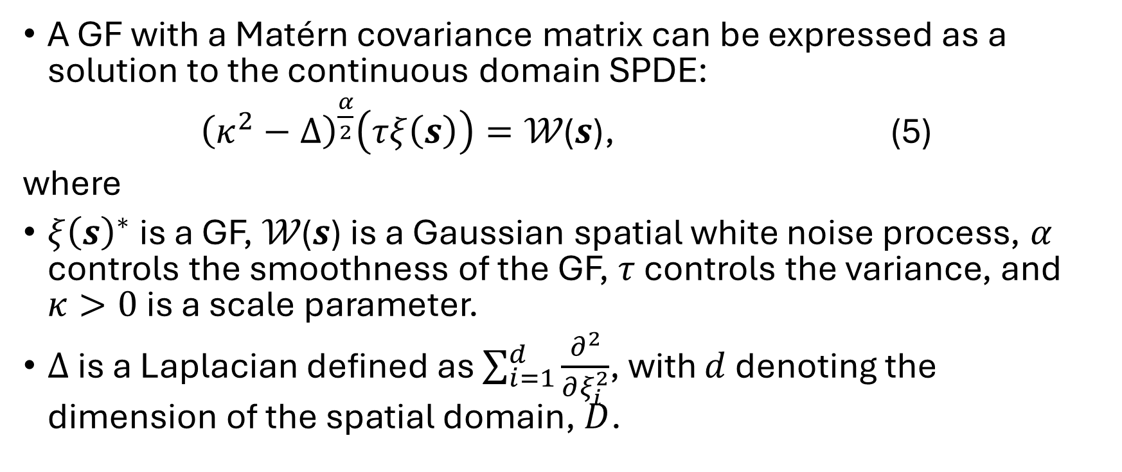
The INLA-SPDE approach
A GF with a Matérn covariance matrix can be expressed as a solution to the continuous domain SPDE:
${\left(κ^{2}−∆\right)}^{\frac{α}{2}}\left(τξ\left(s\right)\right)=\text{𝒲}\text{(}s\text{)}$, (5)
where
$ξ{\left(s\right)}^{∗}$ is a GF, $\text{𝒲(}s\text{)}$ is a Gaussian spatial white noise process, $α$ controls the smoothness of the GF, $τ$ controls the variance, and $κ>0$ is a scale parameter.
$∆$ is a Laplacian defined as $\sum_{i=1}^{d}{\frac{∂^{2}}{∂ξ_{i}^{2}}}$, with $d$ denoting the dimension of the spatial domain, $D$.
What we are solving for!
* $ξ\left(s\right)$ is a generic notation used to denote the GF

Slide 10
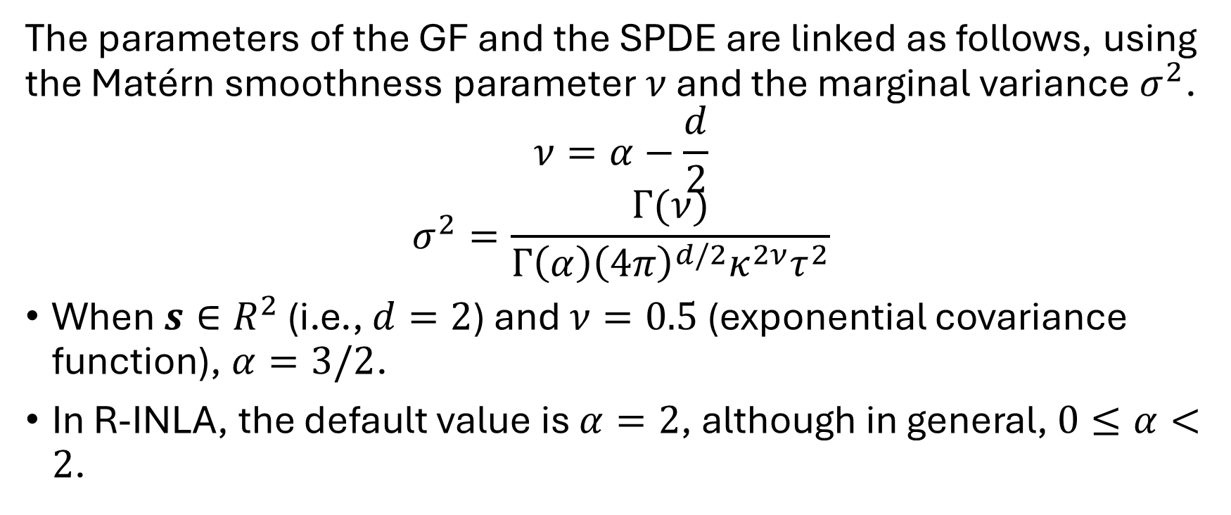
The INLA-SPDE approach
The parameters of the GF and the SPDE are linked as follows, using the Matérn smoothness parameter $ν$ and the marginal variance $σ^{2}$.
$$ν=α−\frac{d}{2}$$
$$σ^{2}=\frac{Γ(ν)}{Γ\left(α\right){\left(4π\right)}^{d/2}κ^{2ν}τ^{2}}$$
When $s∈R^{2}$ (i.e., $d=2$) and $ν=0.5$ (exponential covariance function), $α=3/2$.
In R-INLA, the default value is $α=2$, although in general, $0≤α<2$.

Slide 11
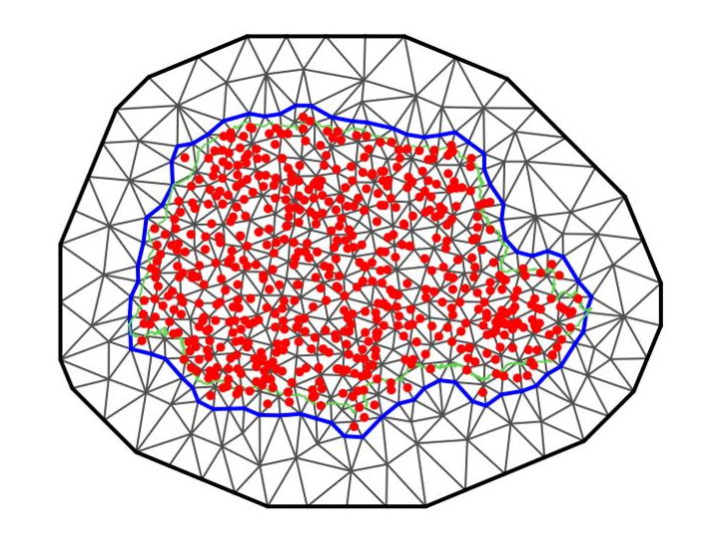
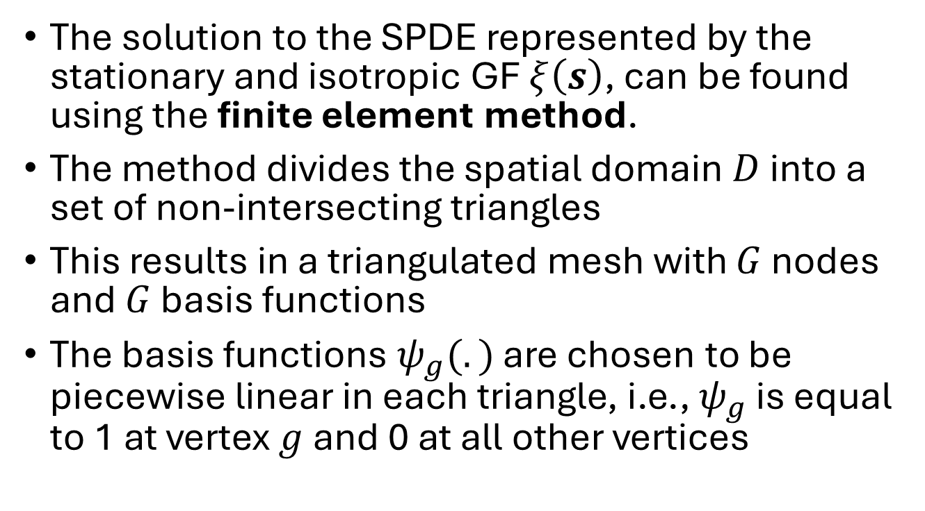
The INLA-SPDE approach
The solution to the SPDE represented by the stationary and isotropic GF $ξ\left(s\right)$, can be found using the finite element method.
The method divides the spatial domain $D$ into a set of non-intersecting triangles
This results in a triangulated mesh with $G$ nodes and $G$ basis functions
The basis functions $ψ_{g}(.)$ are chosen to be piecewise linear in each triangle, i.e., $ψ_{g}$ is equal to 1 at vertex $g$ and 0 at all other vertices

Slide 12
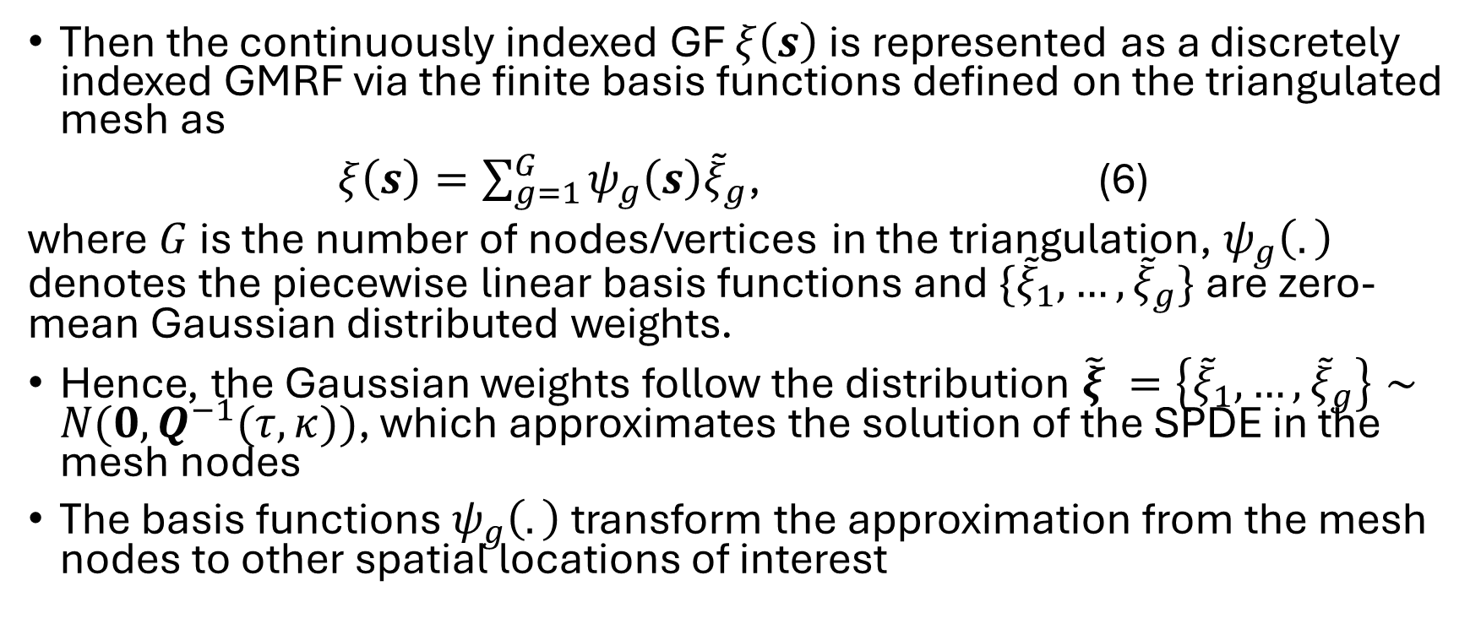
The INLA-SPDE approach
Then the continuously indexed GF $ξ\left(s\right)$ is represented as a discretely indexed GMRF via the finite basis functions defined on the triangulated mesh as
$ξ\left(s\right)=\sum_{g=1}^{G}{ψ_{g}\left(s\right){\tilde{ξ}}_{g}}$, (6)
where $G$ is the number of nodes/vertices in the triangulation, $ψ_{g}\left(.\right)$ denotes the piecewise linear basis functions and $\{{\tilde{ξ}}_{1},…,{\tilde{ξ}}_{g}\}$ are zero-mean Gaussian distributed weights.
Hence, the Gaussian weights follow the distribution $\tilde{ξ} =\left\{{\tilde{ξ}}_{1},…,{\tilde{ξ}}_{g}\right\}∼N(0, Q^{−1}(τ,κ))$, which approximates the solution of the SPDE in the mesh nodes
The basis functions $ψ_{g}\left(.\right)$ transform the approximation from the mesh nodes to other spatial locations of interest
Instead of estimating $ξ\left(s\right)$ at every location, we only estimate $\left\{{\tilde{ξ}}_{1},…,{\tilde{ξ}}_{g}\right\}$ and then use the basis functions the estimate the field at other locations

Slide 13

The INLA-SPDE approach
It can be shown that the precision matrix $Q$ is sparse, hence $ξ$ is a GMRF and it represents the approximated solution to the SPDE.
The key computational chain can be represented as follows.
Continuous spatial field → triangulated mesh → piecewise linear basis functions →
finite set of weights → sparse precision matrix

Slide 14
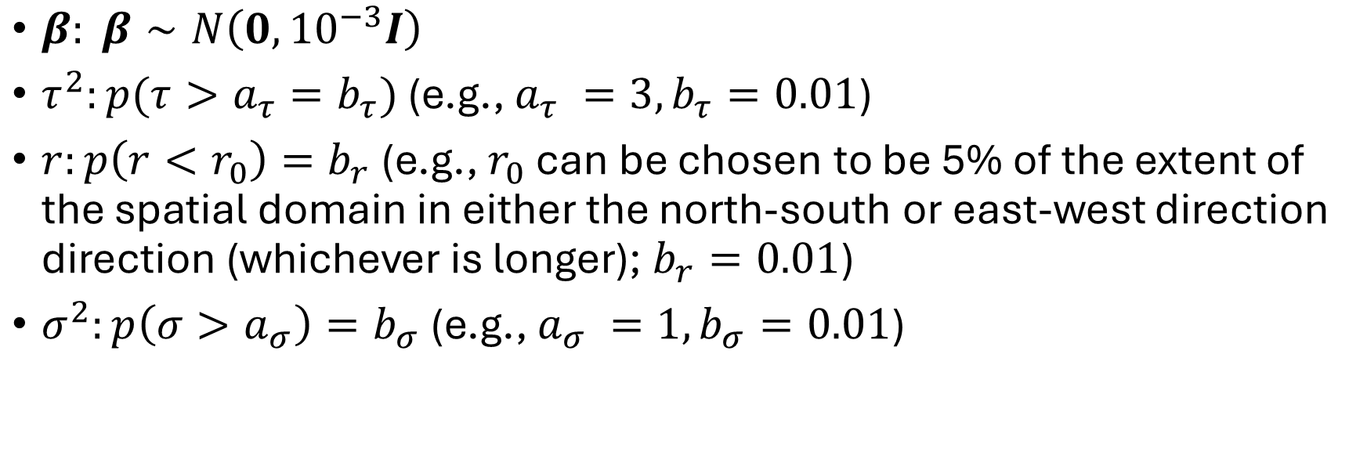
Choosing prior distributions for the parameters
$β: β∼N\left({0,10}^{−3}I\right)$
$τ^{2}:p(τ>a_{τ}=b_{τ})$ (e.g., $a_{τ} =3, b_{τ}=0.01$)
$r:p\left(r<r_{0}\right)=b_{r}$ (e.g., $r_{0}$ can be chosen to be 5% of the extent of the spatial domain in either the north-south or east-west direction direction (whichever is longer); $b_{r}=0.01$)
$σ^{2}:p\left(σ>a_{σ}\right)=b_{σ}$ (e.g., $a_{σ} =1, b_{σ}=0.01$)

Slide 15
The INLA-SPDE approach: mesh construction
In R-INLA, this is done using the function:
inla.mesh.2d(loc = NULL, loc.domain = NULL, offset = NULL,
max.edge = NULL, cutoff = 1e-12,….)
loc: data locations to be used as initial triangulation nodes
loc.domain: boundary points used to determine the domain extent
offset: automatic extension distance - one or two values for an inner and an optional outer extension
max.edge: the largest allowed triangle edge length - one or two values.
cutoff: the minimum allowed distance between points. Points at most as far apart as this are replaced by a single vertex prior to the mesh refinement step.

Slide 16
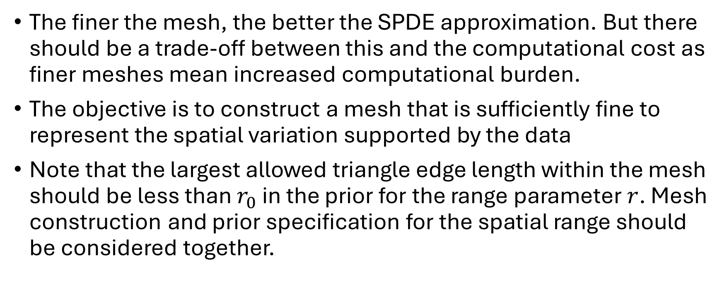
The INLA-SPDE approach: mesh construction
The finer the mesh, the better the SPDE approximation. But there should be a trade-off between this and the computational cost as finer meshes mean increased computational burden.
The objective is to construct a mesh that is sufficiently fine to represent the spatial variation supported by the data
Note that the largest allowed triangle edge length within the mesh should be less than $r_{0}$ in the prior for the range parameter $r$. Mesh construction and prior specification for the spatial range should be considered together.

Slide 17
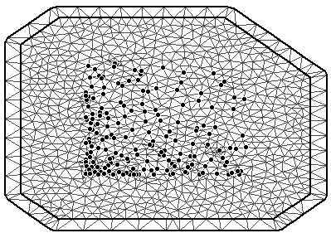
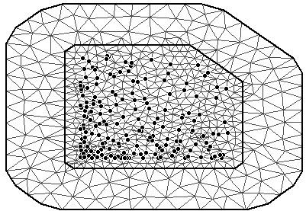
The INLA-SPDE approach: mesh construction
It is very important to plot the mesh and adjust the parameters accordingly if need be
data(SPDEtoy)
coords <- as.matrix(SPDEtoy[,1:2])
mesh1 <- inla.mesh.2d(loc.domain=domain, loc=coords, max.edge=c(0.1, 0.2), offset=c(0.4, 0.1))
mesh2 <- inla.mesh.2d(loc.domain=domain, loc=coords, max.edge=c(0.1, 0.2), offset=c(0.1, 0.4))

Slide 18
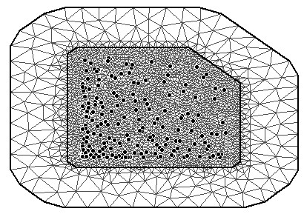
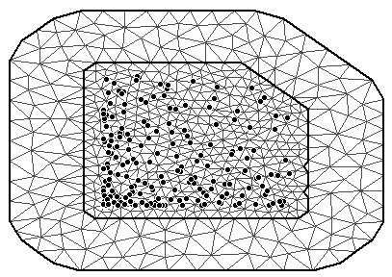
The INLA-SPDE approach: mesh construction
domain <- matrix(cbind(c(0,1,1,0.7,0), c(0,0,0.7,1,1)), ncol=2)
mesh1 <- inla.mesh.2d(loc.domain=domain, max.edge=c(0.04, 0.2), cutoff=0.015, offset=c(0.1, 0.4))
domain <- matrix(cbind(c(0,1,1,0.7,0), c(0,0,0.7,1,1)), ncol=2)
mesh2 <- inla.mesh.2d(loc.domain=domain, max.edge=c(0.04, 0.2), cutoff=0.05, offset=c(0.1, 0.4))
Triangulation points with distance less than 0.015 replaced by a single vertex
Triangulation points with distance less than 0.05 replaced by a single vertex

Slide 19
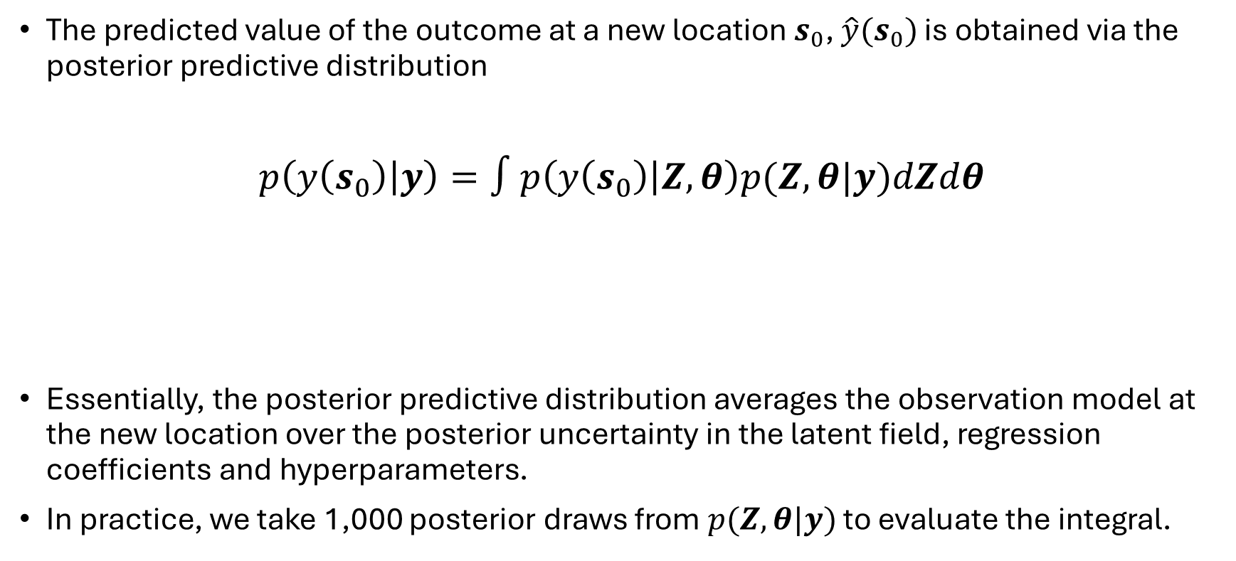
Prediction
The predicted value of the outcome at a new location $s_{0}$, $\hat{y}(s_{0})$ is obtained via the posterior predictive distribution
$p\left(y\left(s_{0}\right) | y\right)=∫p\left(y\left(s_{0}\right) | Z,θ\right)p(Z,θ|y)dZdθ$
Essentially, the posterior predictive distribution averages the observation model at the new location over the posterior uncertainty in the latent field, regression coefficients and hyperparameters.
In practice, we take 1,000 posterior draws from $p(Z,θ|y)$ to evaluate the integral.
Posterior distribution for the latent variable and hyperparameters given the observed data
Likelihood for new observation

Slide 20
Model choice and predictive performance
As with areal data, we can also use the following model choice criteria when working with geostatistical data:
WAIC
DIC
CPO
PIT
PMCC (predictive model choice criteria), etc

Slide 21
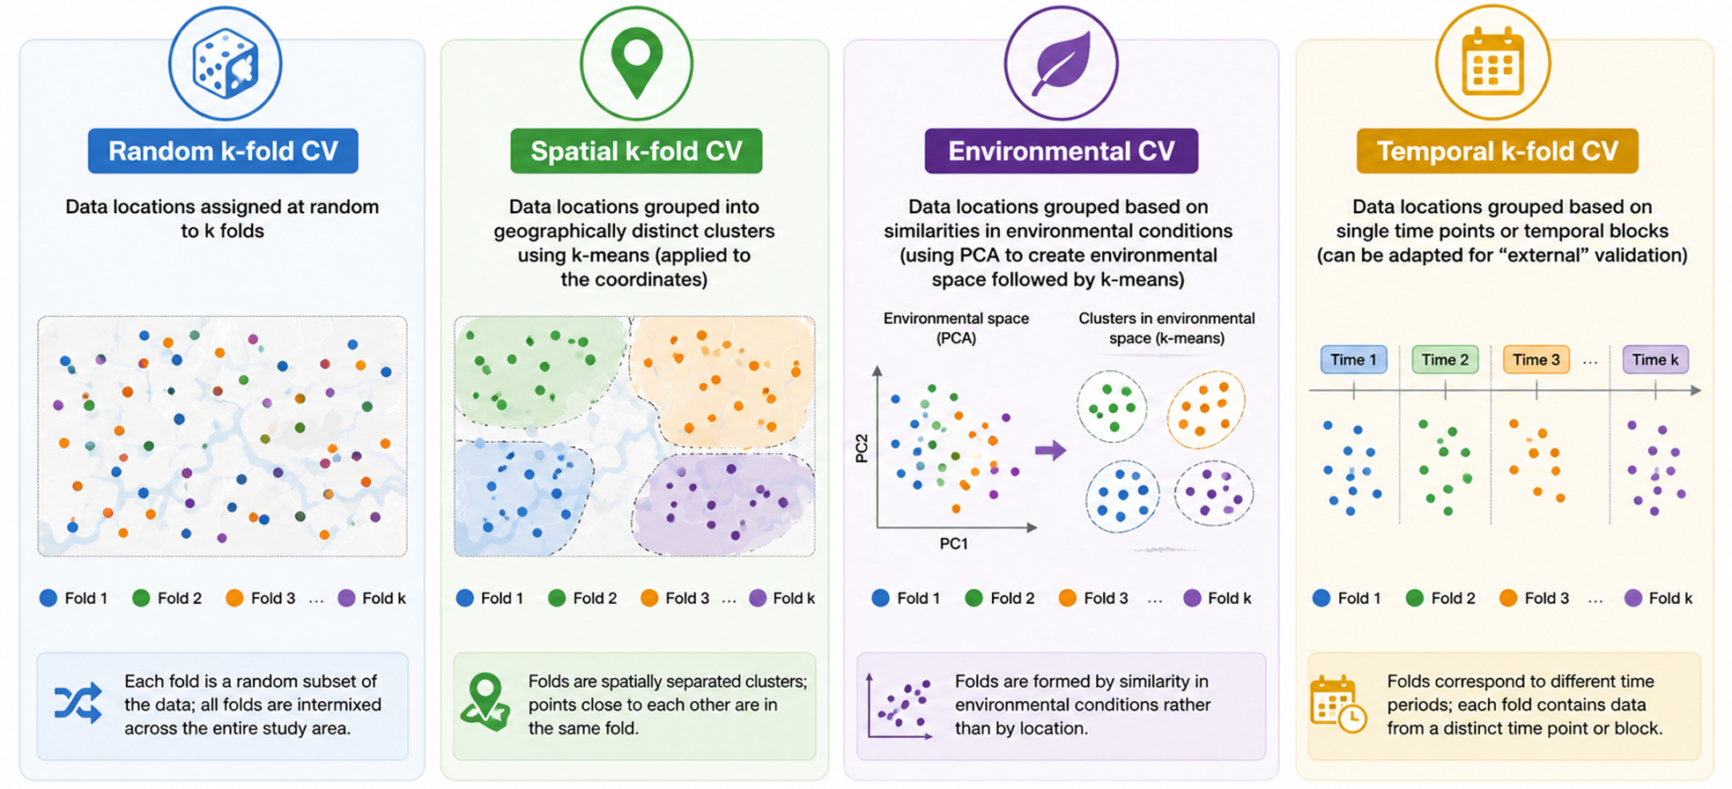
Model choice and predictive performance
When working with geostatistical data, we would often need to use K-fold cross-validation for model choice and to assess out-of-sample predictive performance

Slide 22
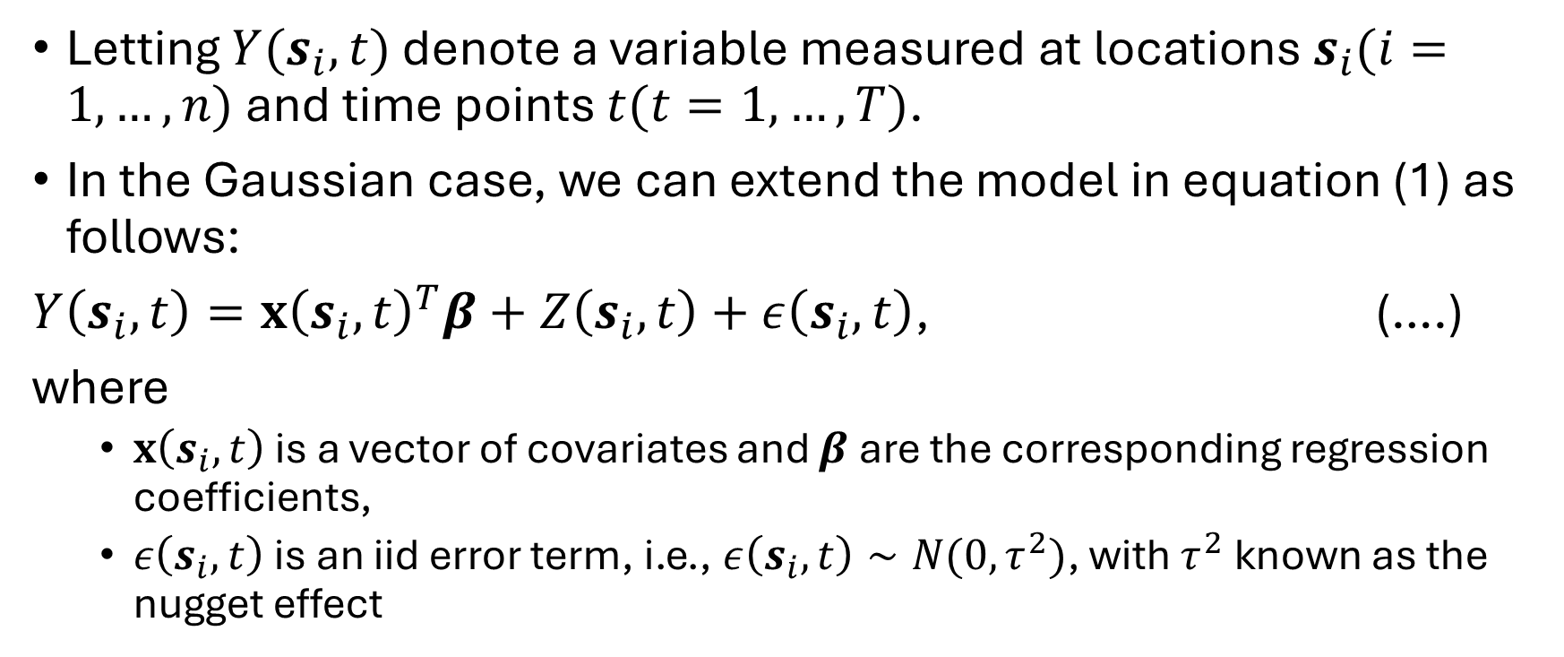
Extending to the spatiotemporal setting
Letting $Y(s_{i},t)$ denote a variable measured at locations $s_{i}(i=1,…,n)$ and time points $t(t=1,…,T)$.
In the Gaussian case, we can extend the model in equation (1) as follows:
$Y\left(s_{i},t\right)=x{\left(s_{i},t\right)}^{T}β+Z\left(s_{i},t\right)+ε\left(s_{i},t\right)$, (….)
where
  $x\left(s_{i},t\right)$ is a vector of covariates and $β$ are the corresponding regression coefficients,
  $ε\left(s_{i},t\right)$ is an iid error term, i.e., $ε\left(s_{i},t\right)∼N(0,τ^{2})$, with $τ^{2}$known as the nugget effect

Slide 23
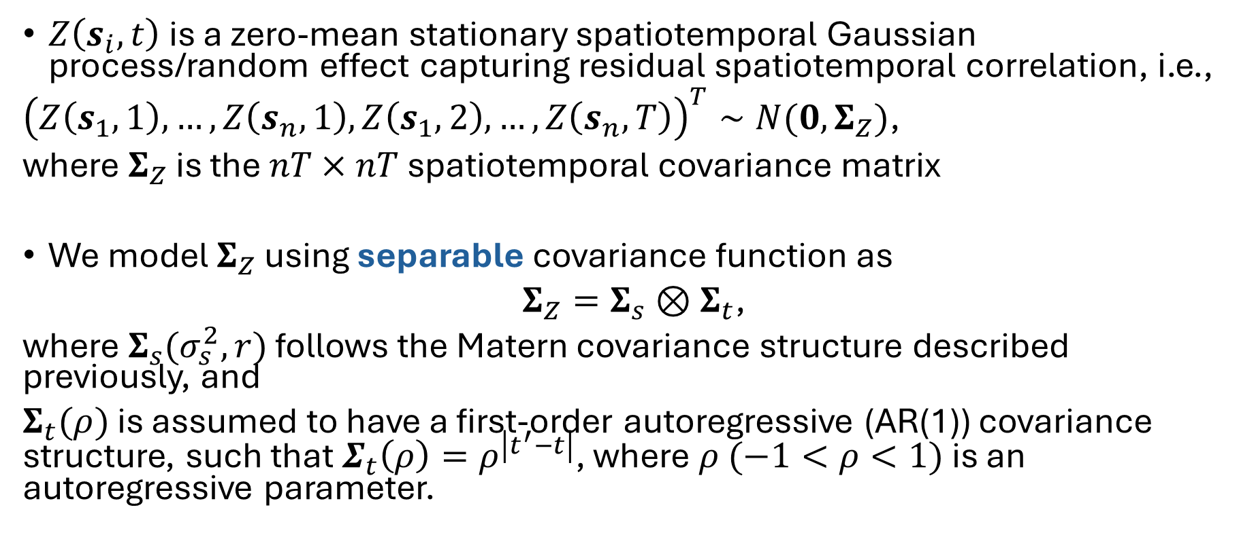
Extending to the spatiotemporal setting
$Z\left(s_{i},t\right)$ is a zero-mean stationary spatiotemporal Gaussian process/random effect capturing residual spatiotemporal correlation, i.e.,
${\left(Z\left(s_{1},1\right),…,Z\left(s_{n},1\right),Z\left(s_{1},2\right),…,Z\left(s_{n},T\right)\right)}^{T}∼N(0, Σ_{Z})$,
where $Σ_{Z}$ is the $nT×nT$ spatiotemporal covariance matrix
We model $Σ_{Z}$ using separable covariance function as
$Σ_{Z}=Σ_{s}⊗Σ_{t}$,
where $Σ_{s}(σ_{s}^{2},r)$ follows the Matern covariance structure described previously, and
$Σ_{t}(ρ)$ is assumed to have a first-order autoregressive (AR(1)) covariance structure, such that $Σ_{t}\left(ρ\right)=ρ^{\left|t^{′}−t\right|}$, where $ρ (−1<ρ<1)$ is an autoregressive parameter.
If we assume an exponential covariance structure, we can write $Σ_{(it,js)}=$ $σ^{2}\exp\left(−\frac{d_{ij}}{φ}\right)×ρ^{|t−s|}$

Slide 24
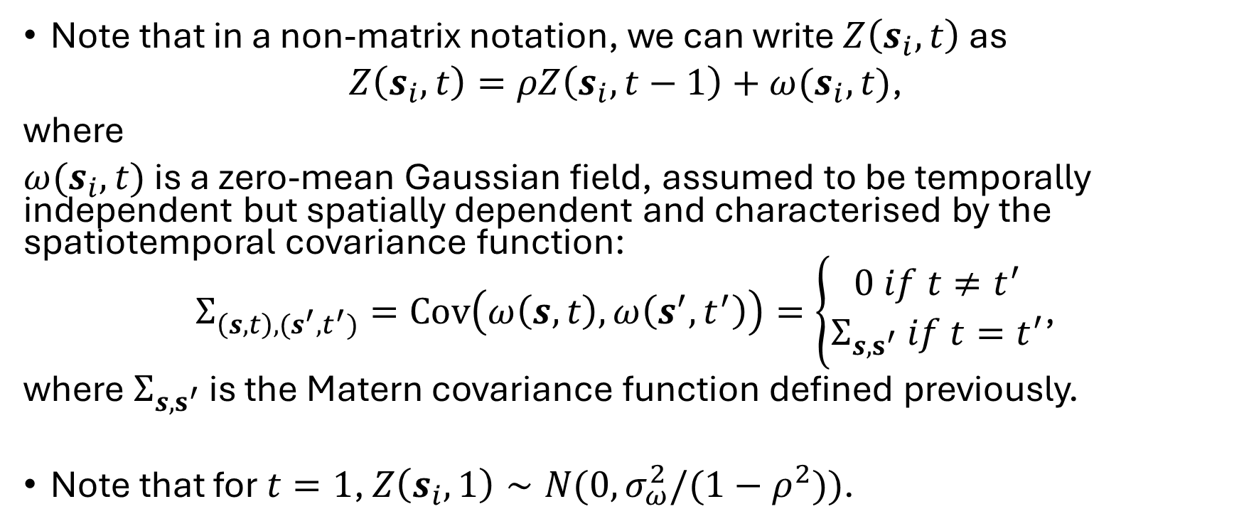
Extending to the spatiotemporal setting
Note that in a non-matrix notation, we can write $Z\left(s_{i},t\right)$ as
$Z\left(s_{i},t\right)=ρZ\left(s_{i},t−1\right)+ω(s_{i},t)$,
where
$ω(s_{i},t)$ is a zero-mean Gaussian field, assumed to be temporally independent but spatially dependent and characterised by the spatiotemporal covariance function:
$Σ_{\left(s,t\right),(s^{′},t^{′})}=Cov\left(ω\left(s,t\right),ω\left(s^{′},t^{′}\right)\right)=\left\{\begin{aligned}0 if t≠t^{′} \\ Σ_{s,s^{′}} if t=t^{′}\end{aligned}\right.$,
where $Σ_{s,s^{′}}$ is the Matern covariance function defined previously.
Note that for $t=1$, $Z\left(s_{i},1\right)∼N(0, σ_{ω}^{2}/(1−ρ^{2}))$.

Slide 25
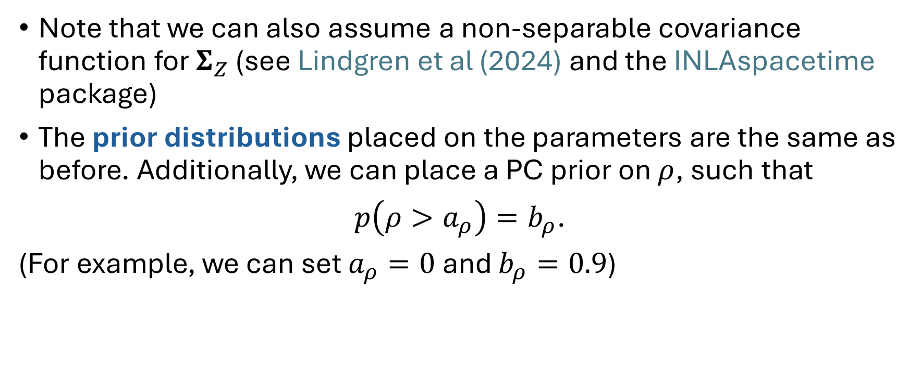
Extending to the spatiotemporal setting
Note that we can also assume a non-separable covariance function for $Σ_{Z}$ (see Lindgren et al (2024) and the INLAspacetime package)
The prior distributions placed on the parameters are the same as before. Additionally, we can place a PC prior on $ρ$, such that
$p\left(ρ>a_{ρ}\right)=b_{ρ}$.
(For example, we can set $a_{ρ}=0$ and $b_{ρ}=0.9$)

Slide 26
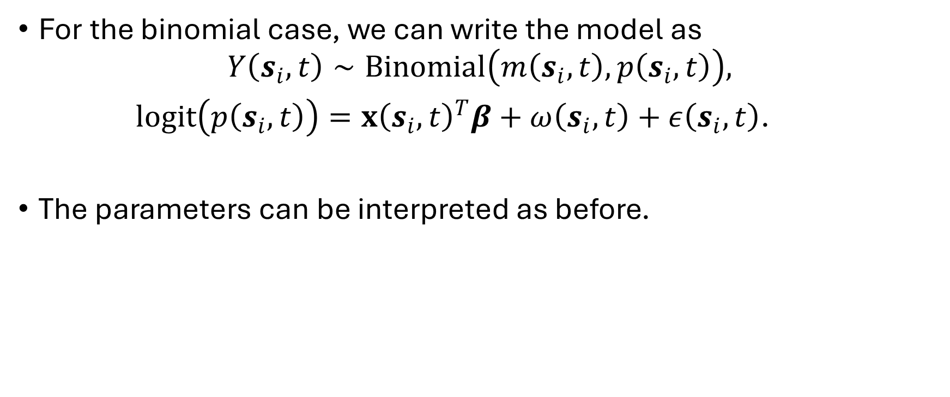
Extending to the spatiotemporal setting
For the binomial case, we can write the model as
$$Y\left(s_{i},t\right)∼Binomial\left(m\left(s_{i},t\right),p\left(s_{i},t\right)\right),$$
$logit\left(p\left(s_{i},t\right)\right)=x{\left(s_{i},t\right)}^{T}β+ω\left(s_{i},t\right)+ε\left(s_{i},t\right)$.
The parameters can be interpreted as before.

Slide 27
Further topics in spatial and spatiotemporal modelling
Hybrid models (combining machine learning and spatial/spatiotemporal models)
Spatial big data
Multivariate models
Spatial and spatiotemporal disaggregation
Emerging Bayesian computational methods (e.g., INLA combined with MCMC)
Data integration (e.g., fusion models) and multi-source spatial modelling (e.g., combining household surveys, routine surveillance, and satellite data).

Slide 28
Exercise 6
Spatial modelling using practice data mimicking cluster level Demographic and Health Survey data on vaccination coverage (same data used for Exercise 5) in Nigeria
Having previously established the presence of residual spatial autocorrelation in the analysis in Exercise 5, we will now fit a spatial model using the data. We will use the model to predict the outcome (vaccination coverage) at 10 x 10 km resolution and then aggregate the predictions to the state level.
The model will be implemented using inlabru.
There are two modelling scripts provided. Run “model_fitting_and_prediction_geographic.R” (Geographic) first and the other script (UTM) later.
Also, you can practice how to perform random k-fold cross-validation for geostatistical models using the script “Cross_validation_script.R”

Slide 29
Exercise 6
The covariates included in the data were identified via a covariate selection process which involved fitting a non-spatial Binomial GLM, checking for (multi)collinearity, log-transforming some covariates to encourage linearity and using stepwise AIC (backward elimination) for final covariate selection.
The selected covariates include travel time to urban areas, pig density, distance to edge of cultivated areas, distance to conflicts, precipitation, proximity to national borders, land surface temperature, EVI and urban/rural residence.

Slide 30
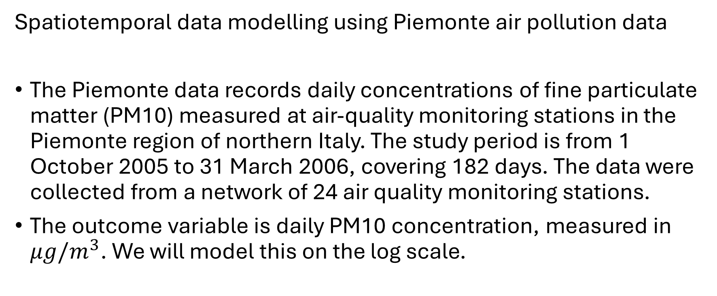
Exercise 7
Spatiotemporal data modelling using Piemonte air pollution data
The Piemonte data records daily concentrations of fine particulate matter (PM10) measured at air-quality monitoring stations in the Piemonte region of northern Italy. The study period is from 1 October 2005 to 31 March 2006, covering 182 days. The data were collected from a network of 24 air quality monitoring stations.
The outcome variable is daily PM10 concentration, measured in $μg/m^{3}$. We will model this on the log scale.

Slide 31
Exercise 7
The covariates include:
TEMP | Daily mean temperature
WS | Daily mean wind speed
HMIX | Daily maximum mixing height
PREC | Daily total precipitation
EMI | Daily emissions of primary aerosols
A | Altitude
The data also includes the projected coordinates (UTMX and UTMY) of the monitoring stations
We will fit a model to the data and use the model to generated an interpolated air pollution surface for day 122. The model is implemented using inlabru.

Slide 32
Some notes
Note that in practice, all the covariates do not have to enter the model in a linear form. Instead of the log-transformation applied to some covariates, we can use smooth functions such as cubic splines to capture nonlinearity between a covariate and the outcome.
Matern covariance functions are a common assumption when using INLA. Exponential covariance functions (simpler) are also common in the literature.

Slide 33
References
Banerjee, S., Gelfand, A. E., & Carlin, B. P. (2025). Hierarchical modeling and analysis for spatial data (3rd ed.). Chapman and Hall/CRC.
Bivand, R. S., Pebesma, E., & Gómez-Rubio, V. (2013). Applied Spatial Data Analysis with R (2nd ed.). Springer.
Blangiardo, M., & Cameletti, M. (2015). Spatial and spatio-temporal Bayesian models in R-INLA, John Wiley & Sons
Moraga, P. (2019). Geospatial health data: Modeling and visualization with R-INLA and Shiny. CRC Press.
Sahu, S. K. (2022). Bayesian modelling of spatio-temporal data with R. Chapman and Hall/CRC.
Schabenberger, O., & Gotway, C. A. (2005). Statistical methods for spatial data analysis. Chapman & Hall/CRC.

